Slide 1

Walkers Creek and Beamer Creek Floodplain Mapping Update
What Has Changed?
Steve Miller, P.Eng.
Senior Manager, Water Resources

Slide 2
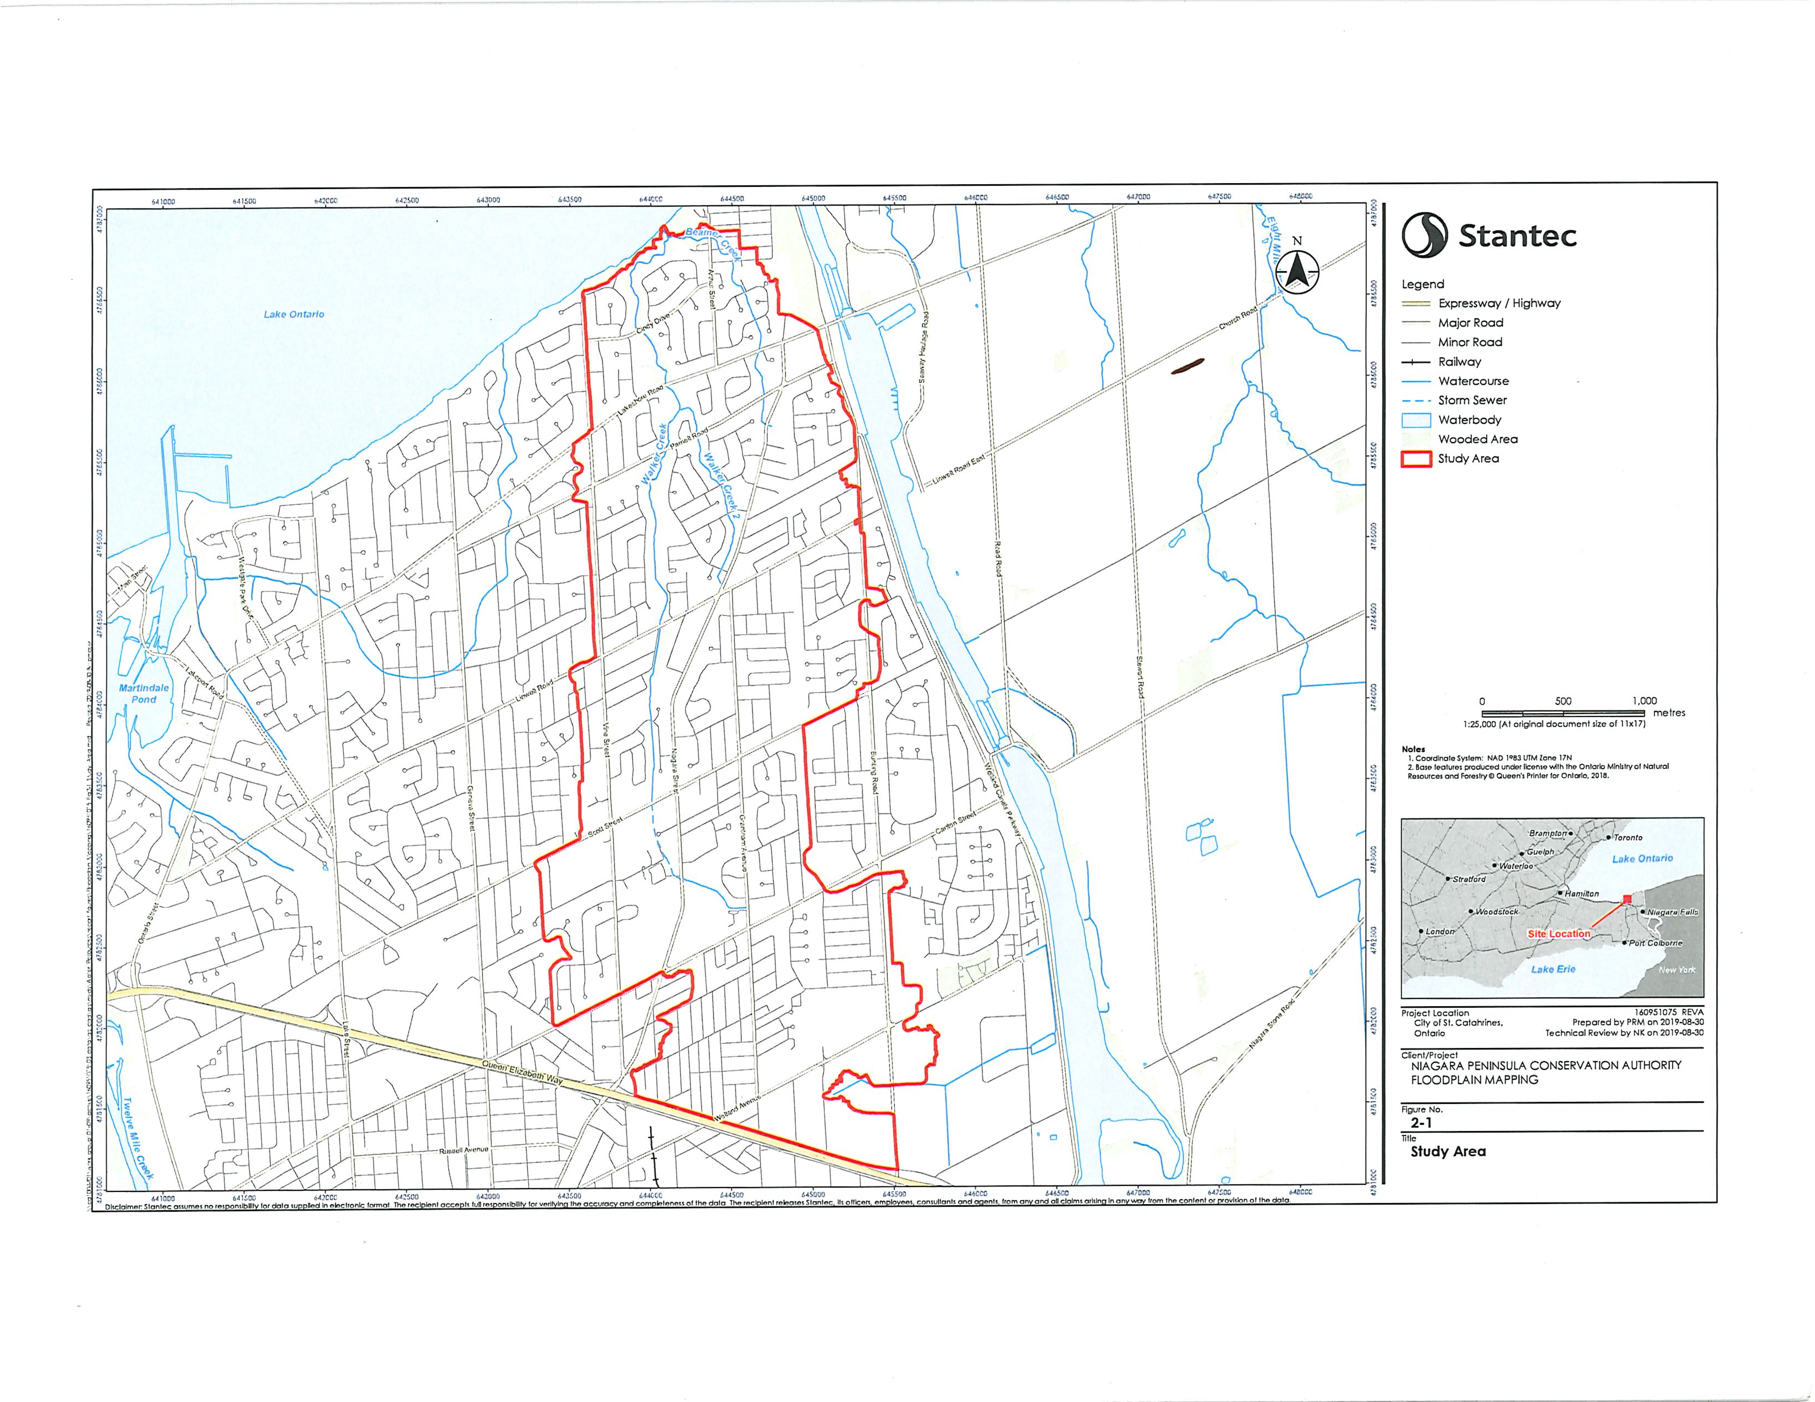
Drainage Area approx. 8.0 square kilometers (2,000 acres)

Slide 3
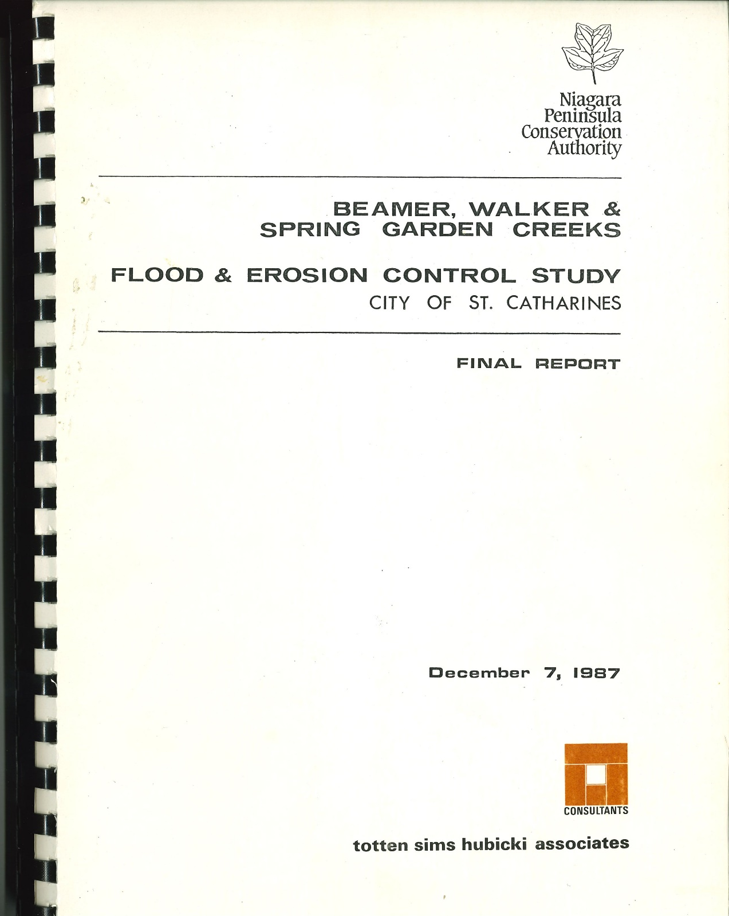
December 7, 1987

Slide 4
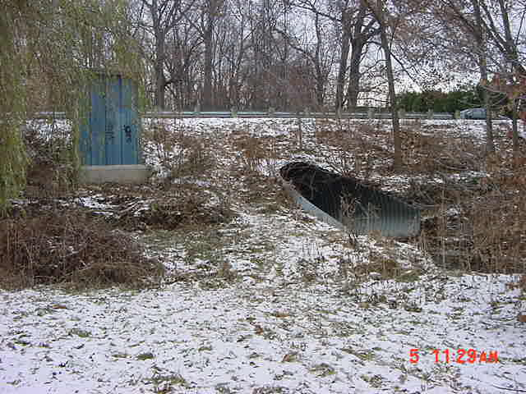
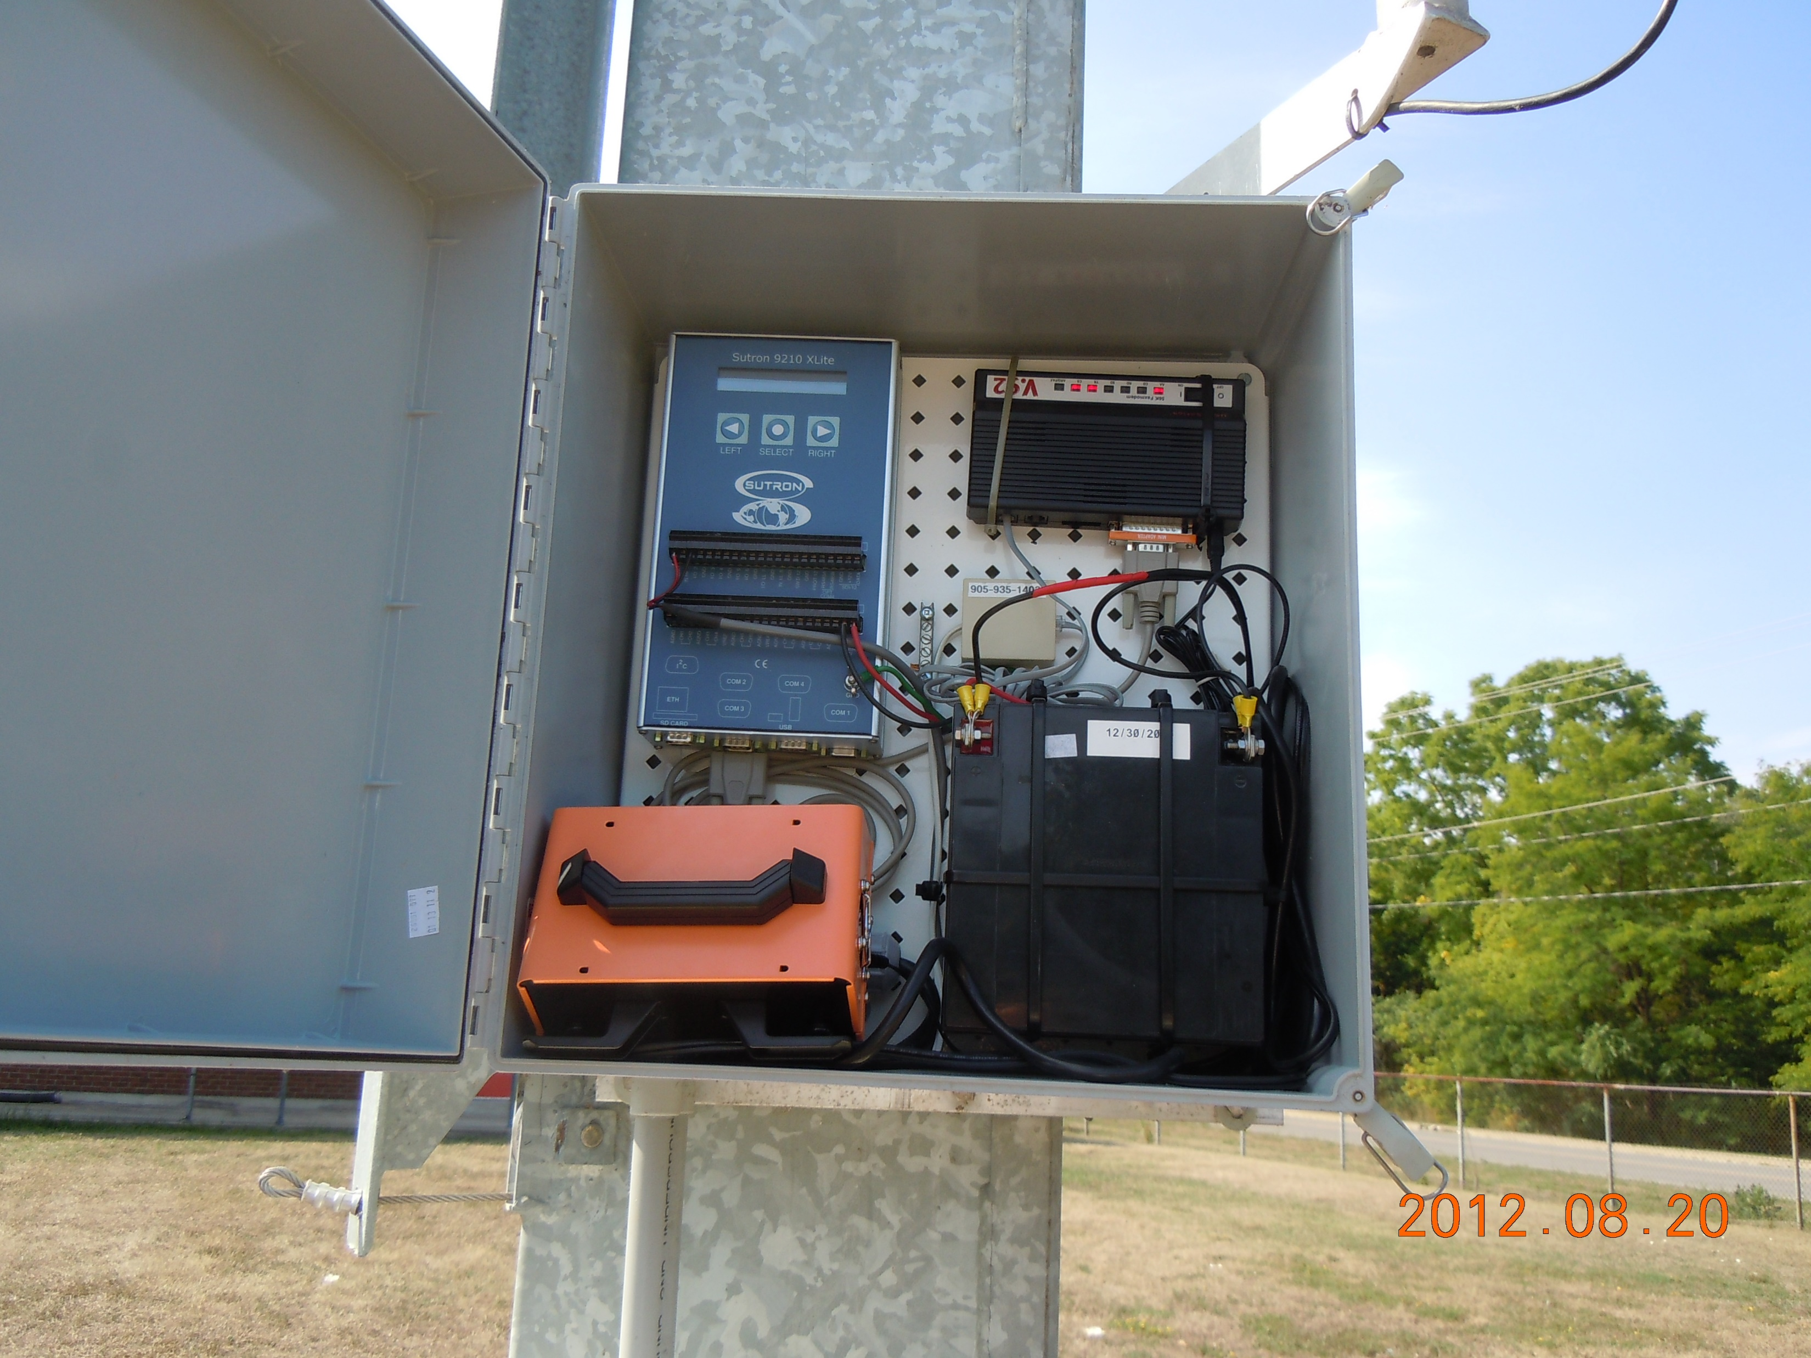
Cindy Drive Stream Gauge
Port Dalhousie WWTP Rain Gauge

Slide 5
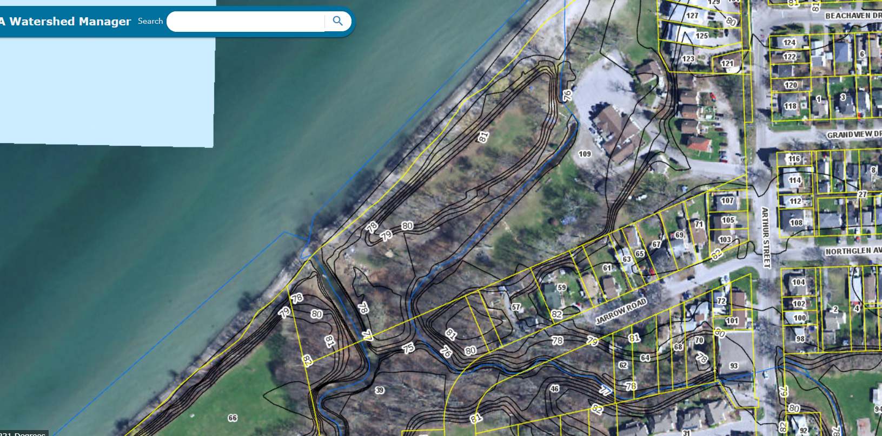

Slide 6
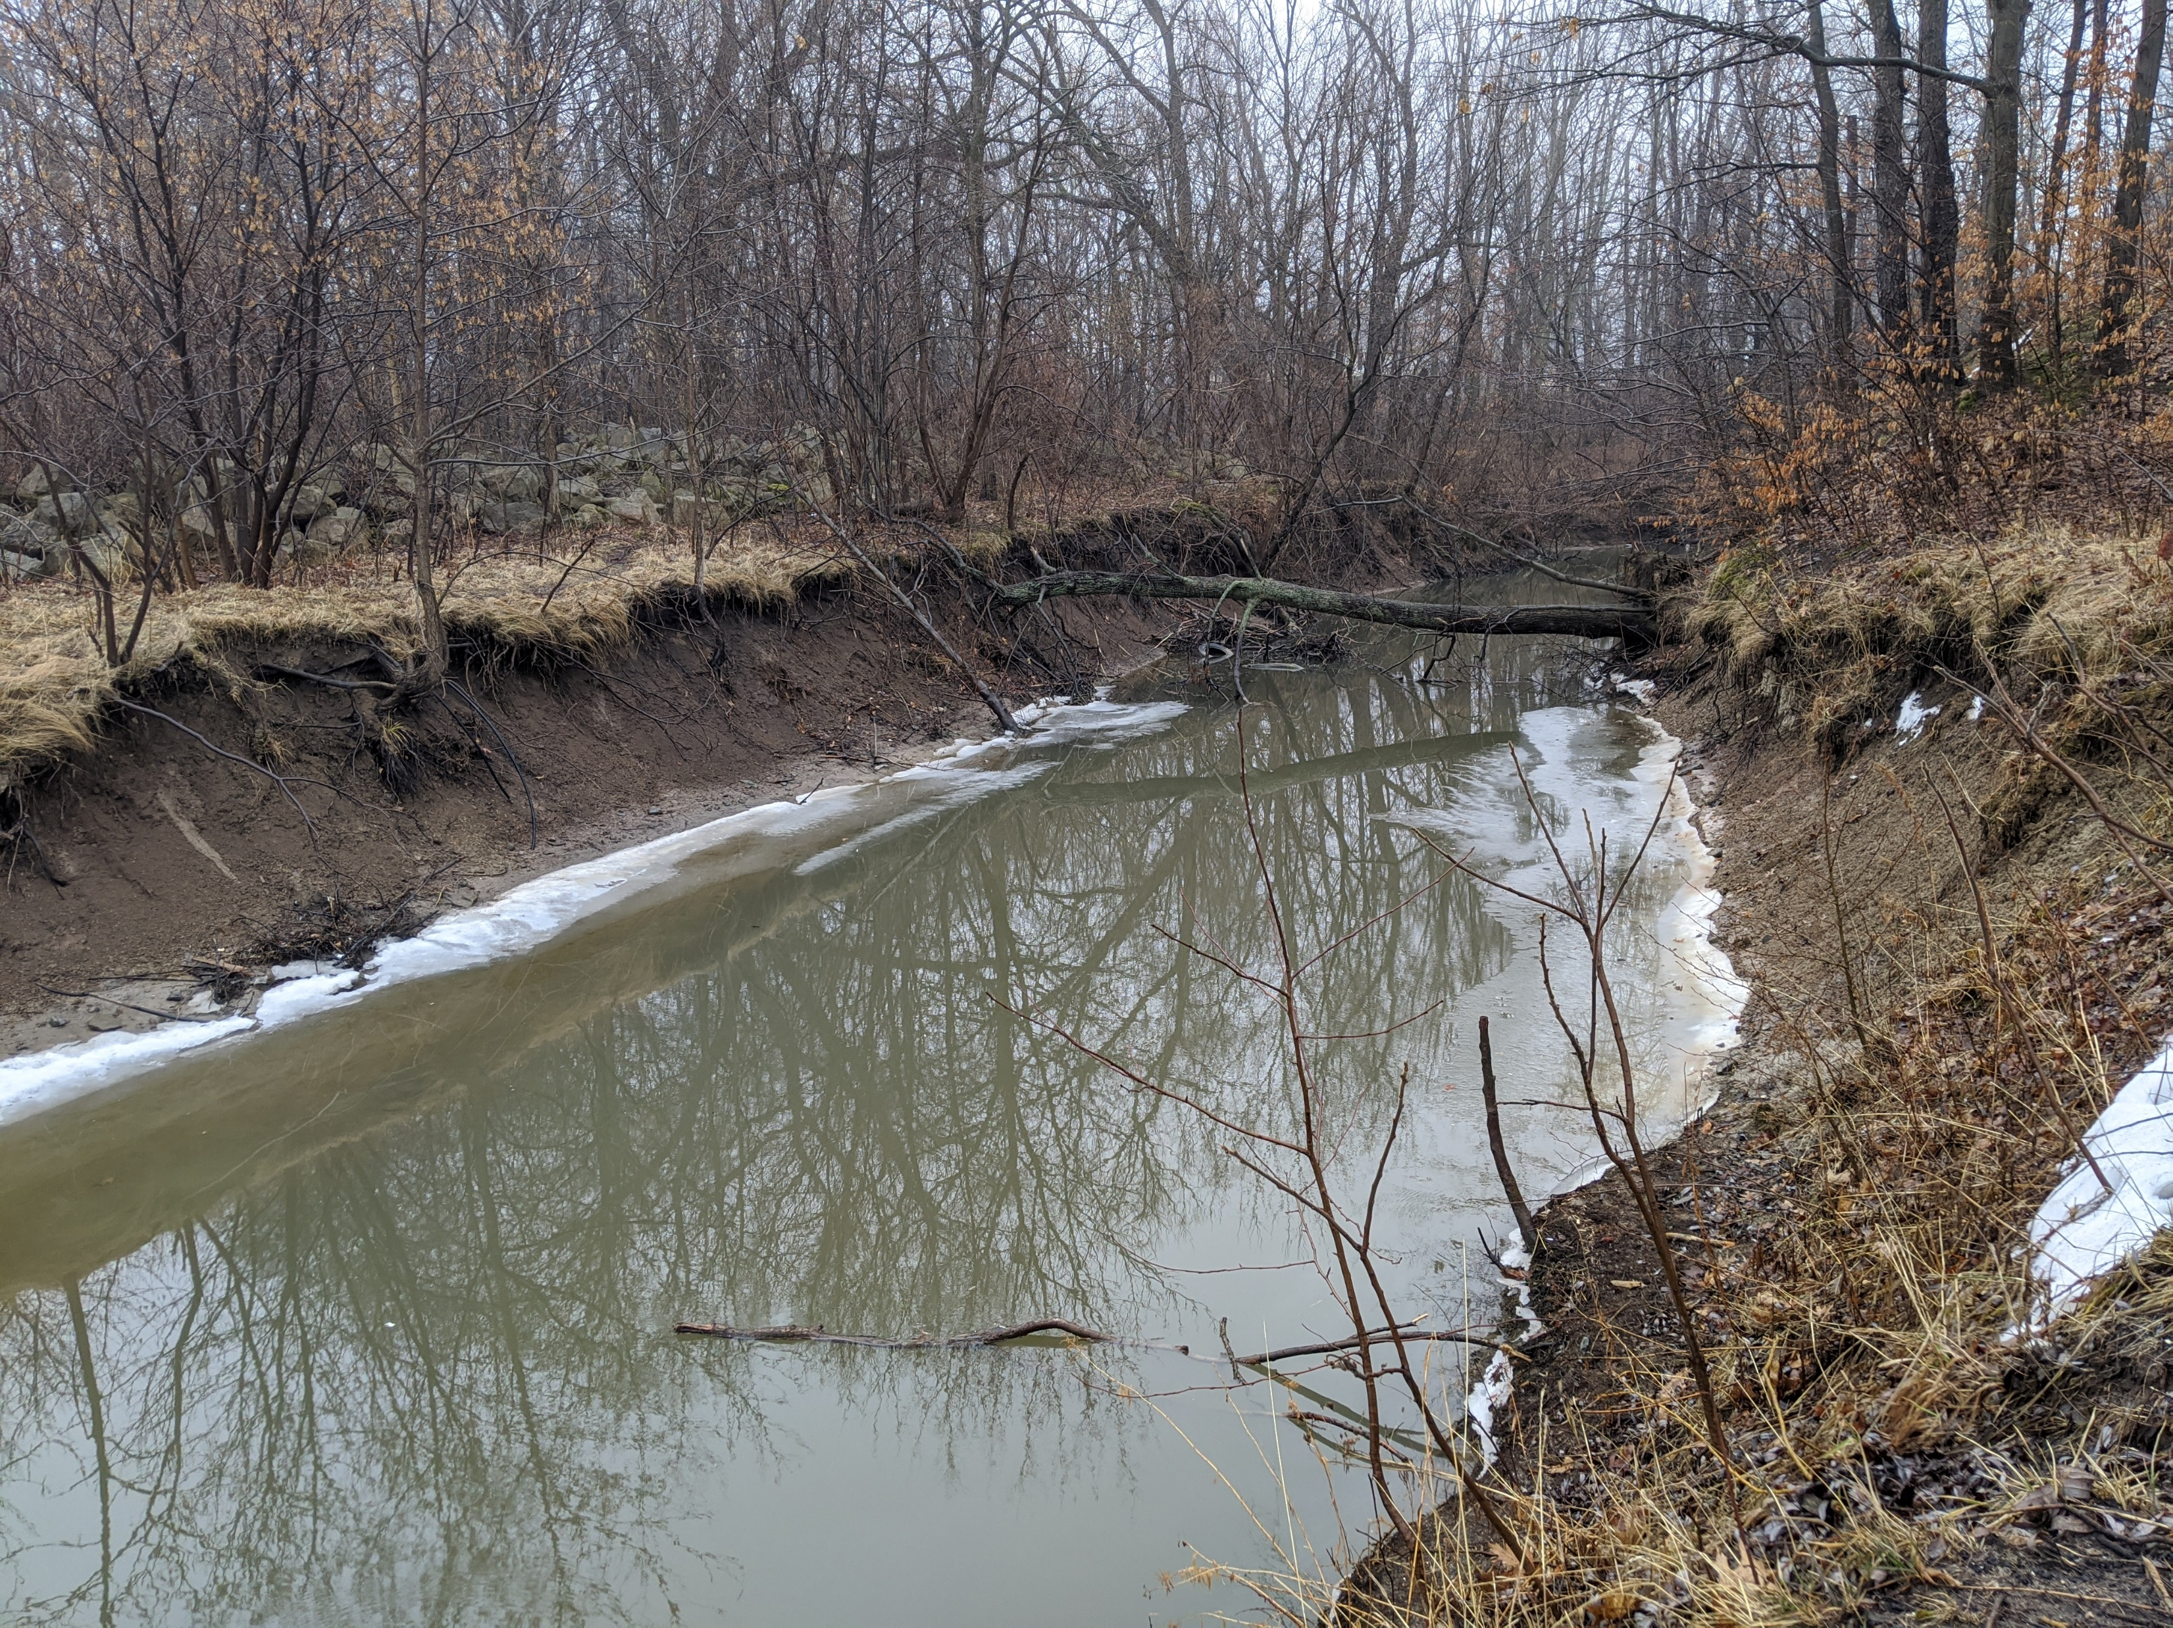
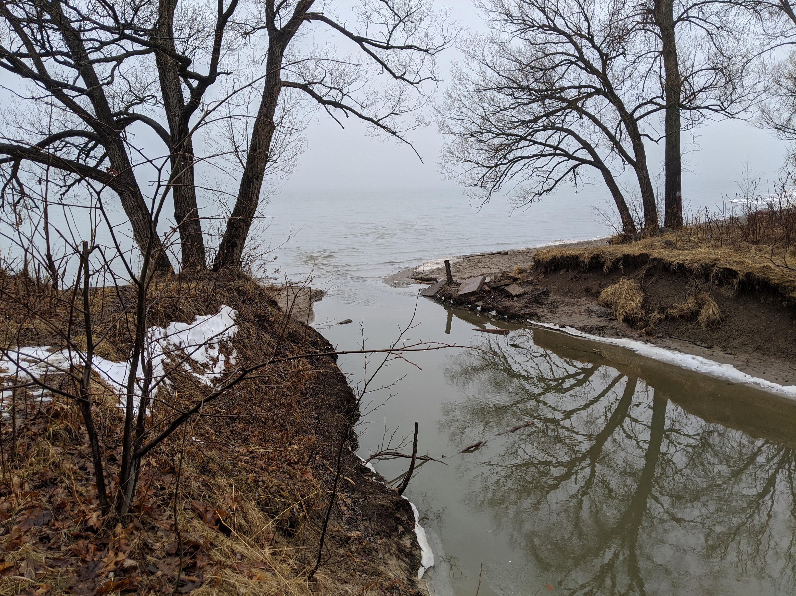

Slide 7
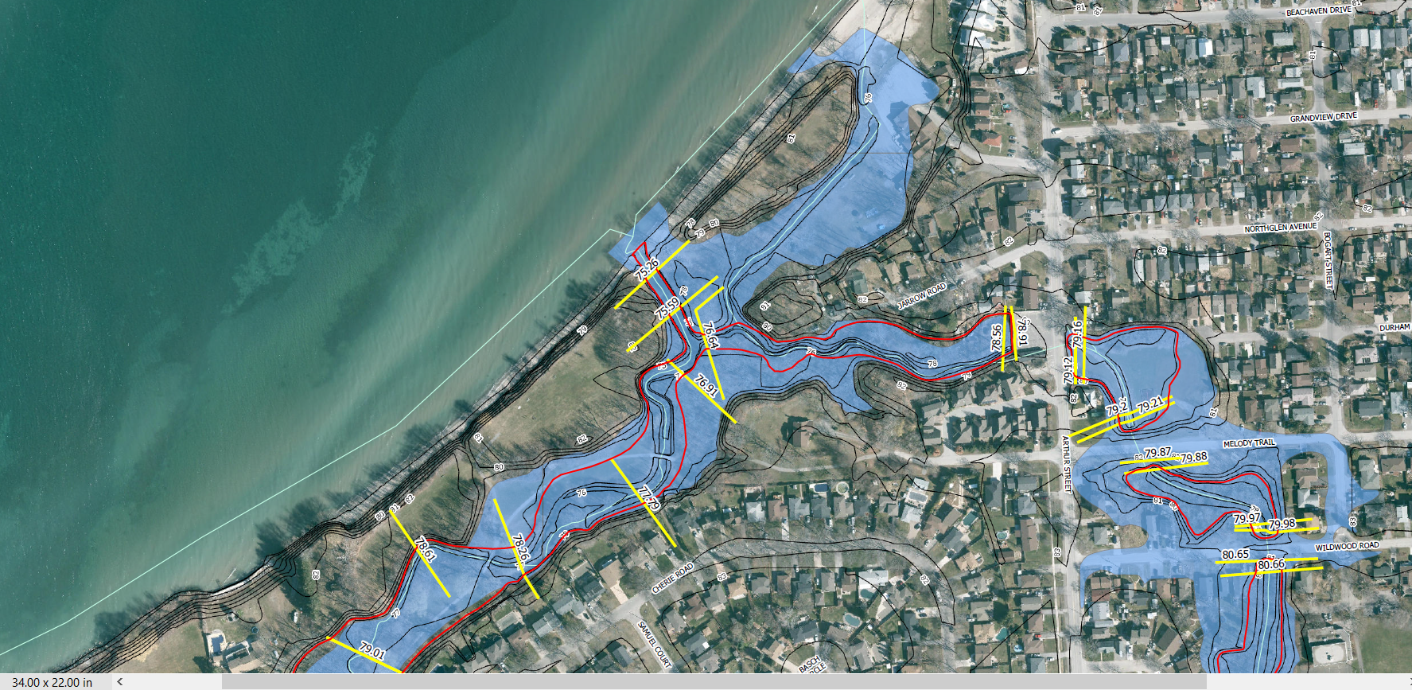

Slide 8
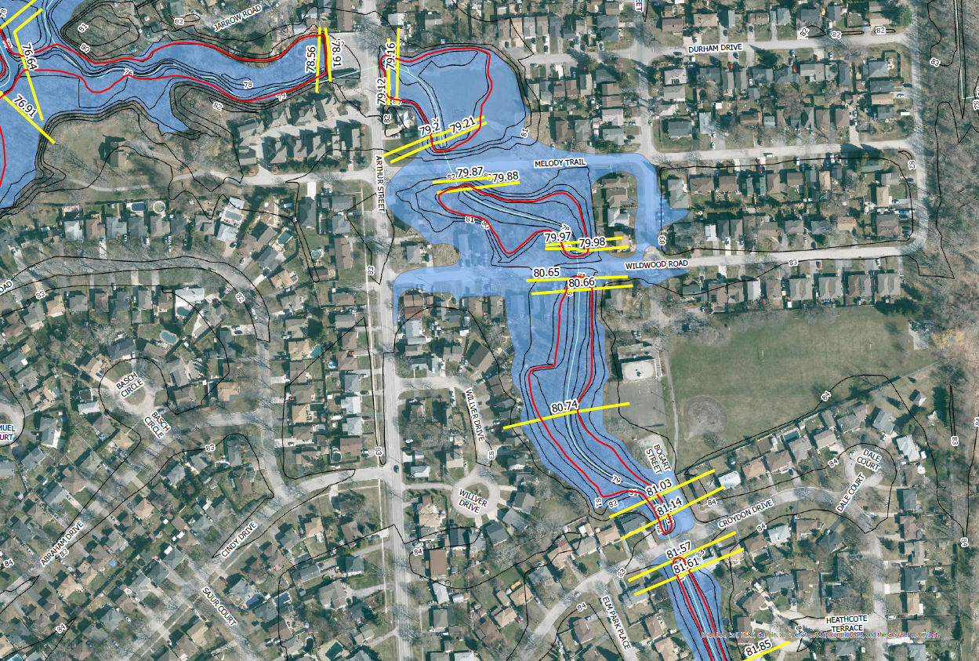

Slide 9
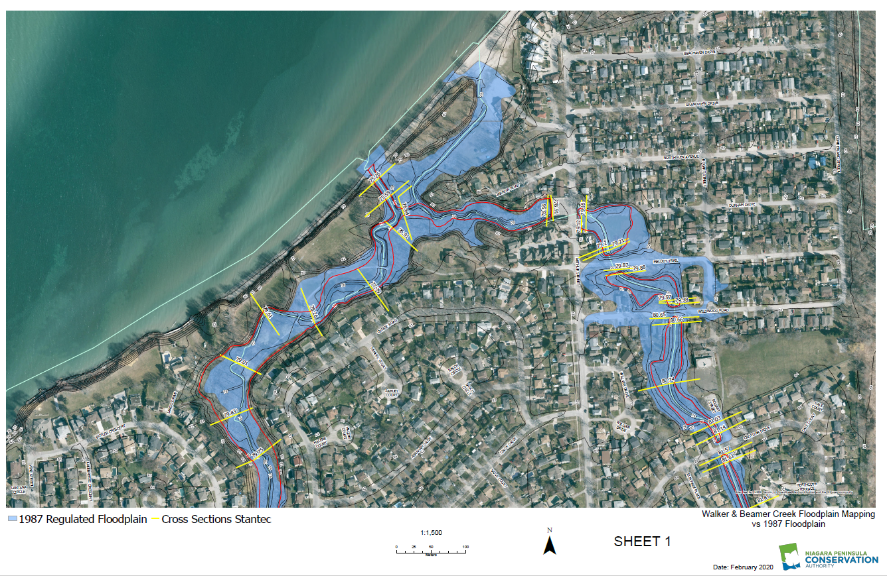

Slide 10
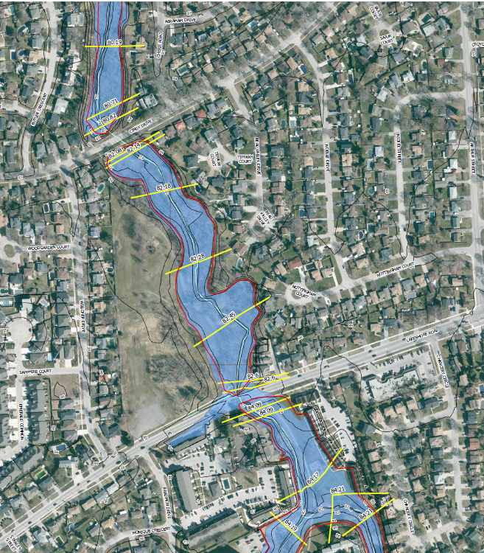
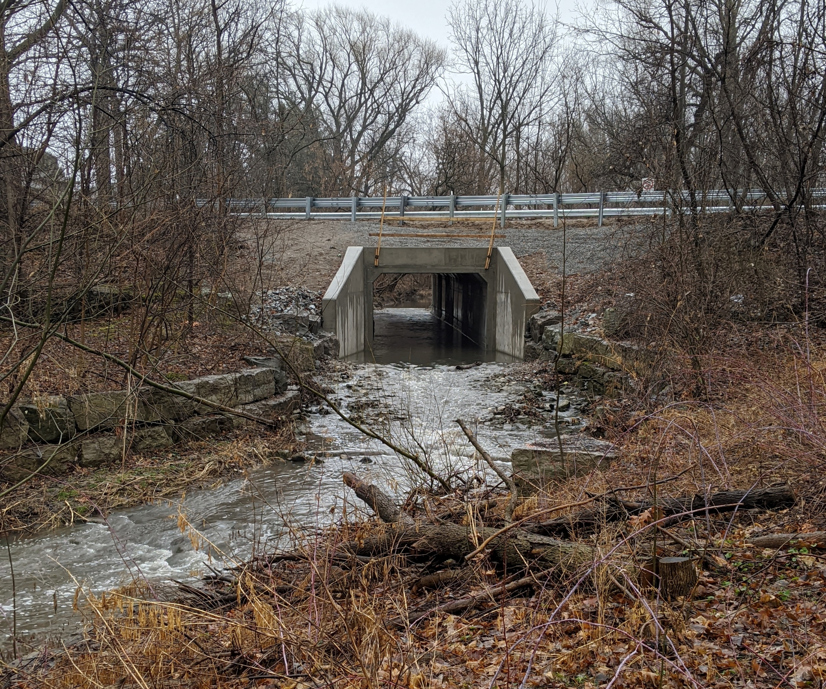
Cindy Drive

Slide 11
Thank you!
Questions?

Slide 12
Walkers Creek and Beamer Creek Floodplain Mapping Update
NPCA Floodplain Policies
David Deluce, MCIP, RPP.
Senior Manager, Planning & Regulations

Slide 13
Legislative Context
  Conservation Authorities Act – Section 28
  Ontario Regulation 155/06
    Subsection 2(1) – Development prohibited; and
    Subsection 3(1) – Permission to Develop
  Planning Act
    Section 3 – Provincial Policy Statement

Slide 14
NPCA Policies
  New document approved September 2018
  Underwent extensive public and stakeholder consultation
  Provides context for WHY we regulate a floodplain
  Describes requirements for establishing two-zone floodplain
  Policies guide NPCA decision making

Slide 15
What is Allowed?
  Passive open space uses
  Accessory structures (subject to criteria)
  Additions to existing buildings (up to 46.5 square metres)
  Up to 50 cubic metres of clean fill
  More flexibility around cut and fill
  Other uses

Slide 16
What is Not Allowed?
  Sensitive uses, such as hospitals, nursing homes, day-cares/pre-schools and schools
  Emergency services facilities
  Uses associated with the disposal, treatment, manufacturing/processing or storage of hazardous substances
  Any other use or development deemed to be inappropriate based on the objectives stated in 4.2.1.

Slide 17
Planning Applications
  Conservation Authorities have MOU with the Province
  Provide comments on Natural Hazards (Section 3.1) of the Provincial Policy Statement
  Can lead to scenarios where could support a Permit but not a Planning application
  Lot creation generally not supportable

Slide 18
Upcoming Changes
  Conservation Authorities Act recently amended by Bill 108.
  Province working on replacing individual Regulations with one Regulation for all Cas.
  Unknown exactly what the new Regulation will include.
  Timeline likely this Fall.

Slide 19
Thank you!
Questions?

